Slide 1

EA
Non-Intrusive Polynomial Chaos Expansion Applied to Full-Order Stochastic CFD
ALVES HAILER Raphael
AÏT AMMAR Yani
13/03/2024

Slide 2
I.
II.
III.
Introduction to Uncertainty Quantification
Theory of NIPCE
Case study : Lid-Driven Cavity Problem
3
4
5
IV.
V.
Case study : NACA0012 Airfoil
Conclusion and Outlook
6
7

Slide 3
I. Introduction to Uncertainty Quantification (UQ)

Slide 4
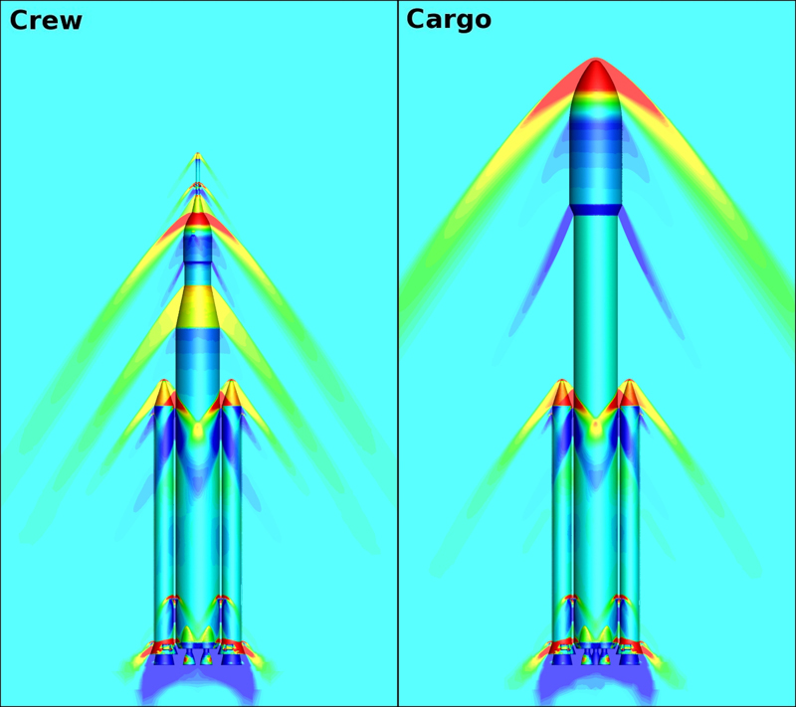
Importance of CFD & Deterministic Approach Challenges
CFD : a critical piece of every engineering projects.
Cost & Time efficient.
Extensive conditions & designs testing.
Pre-experimental decision support.
Deterministic approach limits.
1 solution for 1 given set of input.
Lot of uncertainties in dynamic systems.
Need for Uncertainty Quantification !
Image Credit : NASA

Slide 5
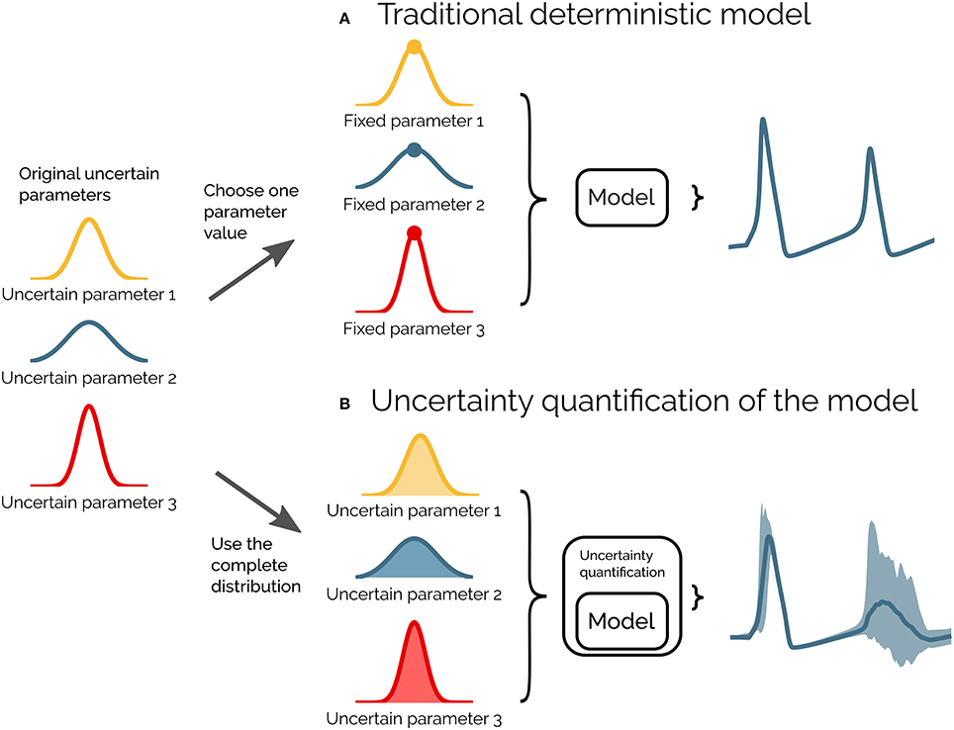
Uncertainty Quantification
UQ Goals :
Assess reliability of predictions.
Manage variability.
Assist in decision-making.
Uncertainty Types :
Aleatoric : Inherent randomness.
Epistemic : Knowledge gaps.
Key Methods :
Deterministic : Error propagation using sensitivity derivatives,…
Probabilistic ones : Monte Carlo, PCE,...
Image Credit : https://www.frontiersin.org/articles/10.3389/fninf.2018.00049/full

Slide 6
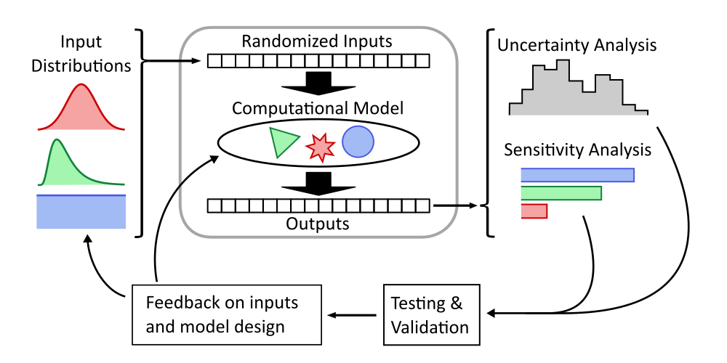
Monte Carlo Method and the Push for Alternatives
Monte Carlo Basics :
Intuitive and easy implementation.
Statistical analysis : calculate mean, variance, determines confidence intervals.
Limitations :
High sample requirement.
Prohibitive computation cost.
Image Credit : Scott Shambaugh
Need for alternatives : PCE and NIPCE as promising and efficient UQ solutions.

Slide 7
II. Theory of NIPCE

Slide 8
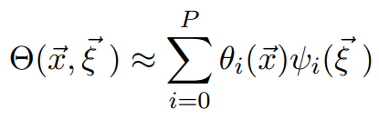
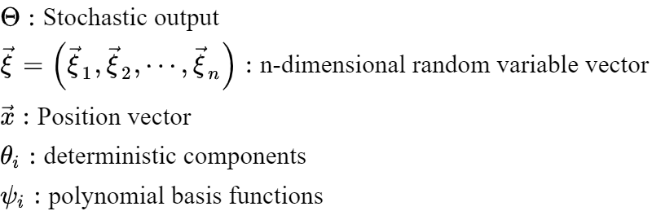
Fundamentals
Polynomial Chaos Expansion (PCE) is a polynomial surrogate model
It is also a linear combination in an orthogonal polynomial basis, weighted by deterministic coefficients

Slide 9
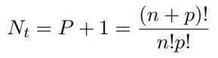

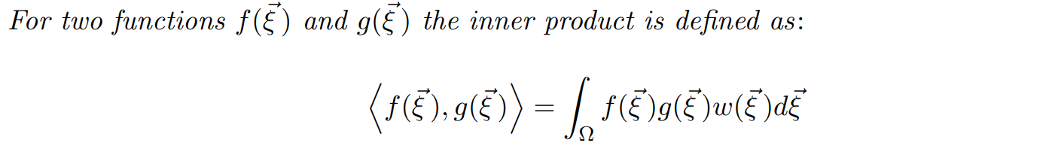
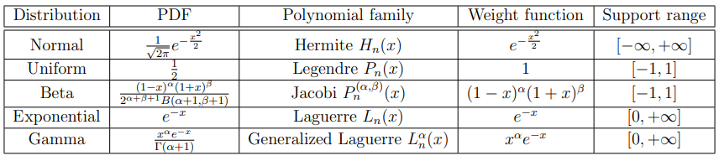
Fundamentals
Total number of elements of approximation:
Optimal polynomial basis depends on Probability Density Function (PDF) of components, because orthogonality depends on the weight function

Slide 10
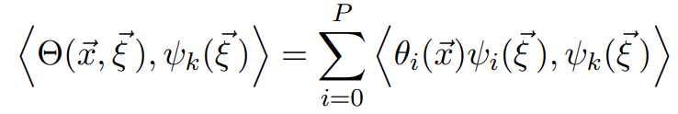
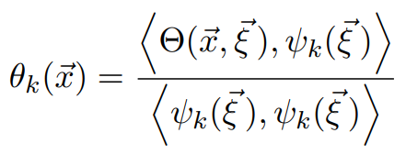
Fundamentals
With the inner product defined, we can project the PCE on the k-th basis
Due to orthogonality of the basis:

Slide 11
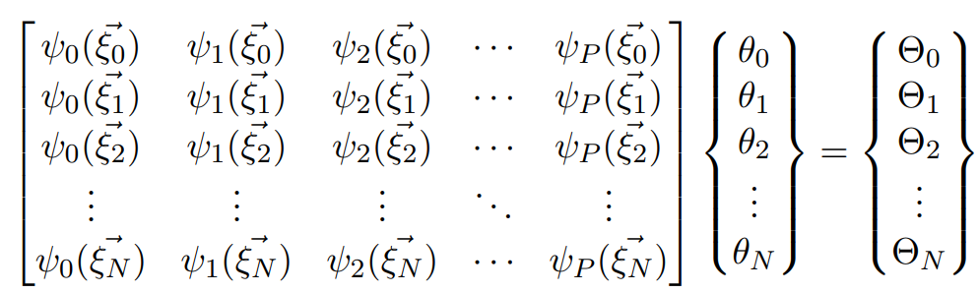
Point-collocation method
NIPCE: Non-Intrusive Polynomial Chaos Expansion
Many methods are available for a non-intrusive approach, but the selected one is point-collocation
Take N+1 different input scenarios.
if N=P, then we have a square linear system, thus there is a unique solution

Slide 12
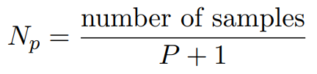
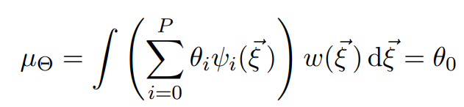
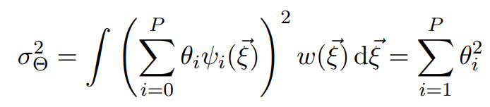
Point-collocation method
Common practice: take more samples than needed
Oversampling ratio:
Solve oversampled system by using regression: least squares minimization
Stochastic post-processing:

Slide 13

Methodology
Full Order Model (FOM) used: OpenFOAM
2 test cases studied:
Lid-driven cavity problem
Dynamical characterization of NACA0012 airfoil
1st test case: demonstrate the use of the NIPCE method with the chaospy
2nd test case: parametric study
We will validate the PCE results by comparing with the FOM and literature

Slide 14
III. Case study : Lid-driven cavity problem

Slide 15
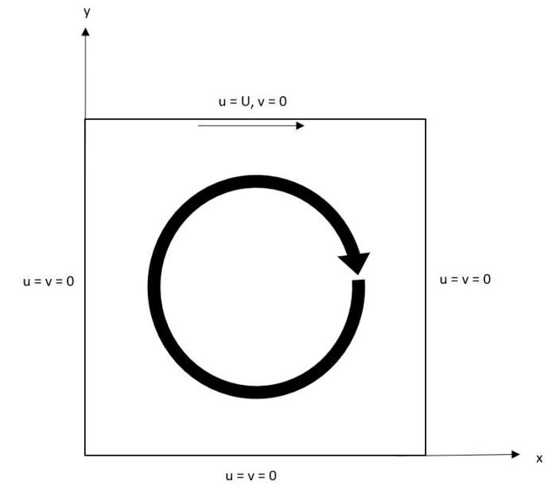
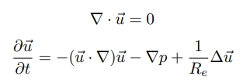
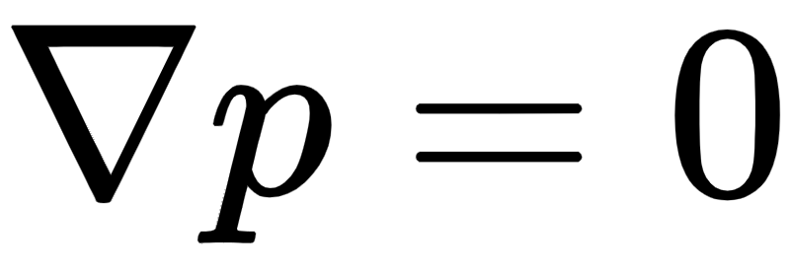
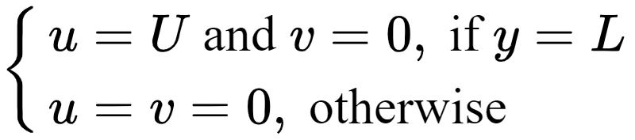
Formulation of the problem
Domain: square with side length L
Physics behind the problem:
Reynolds number is the only parameter influencing the simulation
Literature to compare: Ghia et al.
Boundary conditions:
pressure:
velocity:

Slide 16
OpenFOAM implementation
First step: determine where the solver used is reliable
OpenFOAM solver selected is icoFoam
solves the incompressible laminar Navier-Stokes equations using the PISO (Pressure-Implicit with Splitting of Operators) algorithm
Transient code
Secondly: Determine the minimum final step and number of cells to achieve convergence
Finally: Reynolds number will be the only parameter influencing results, thus we can use the PCE method and assess its validity

Slide 17
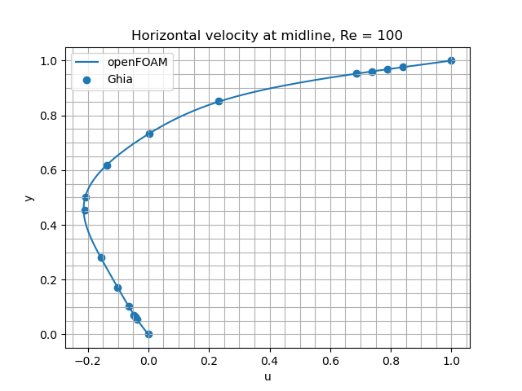
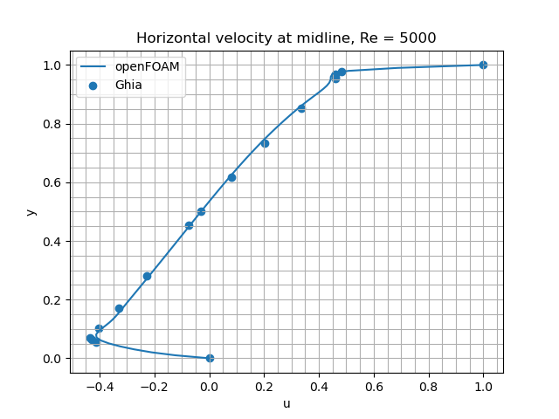
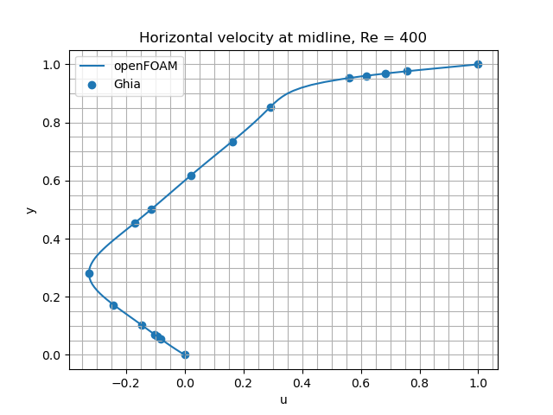
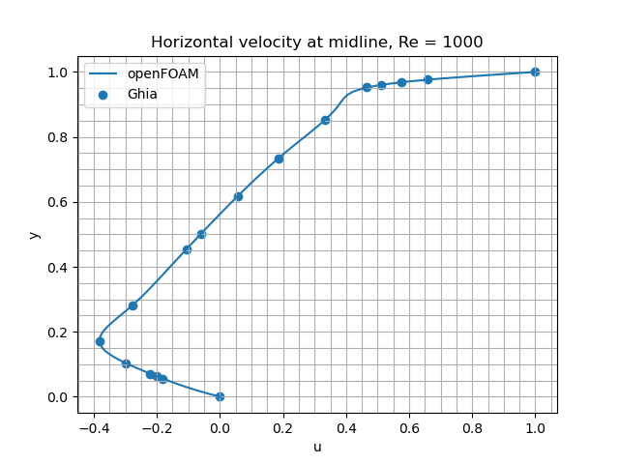
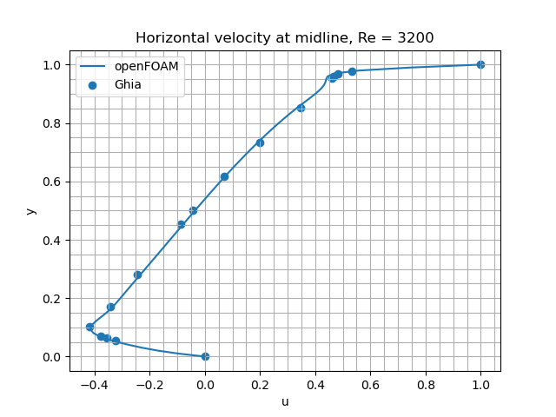
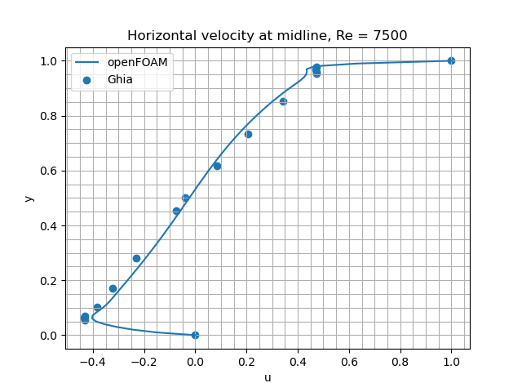

First step of analysis: Determine where the solver is reliable

Slide 18
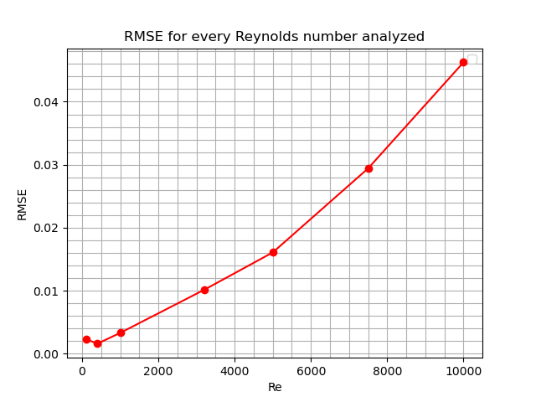
First step of analysis: Determine where the solver is reliable

Slide 19
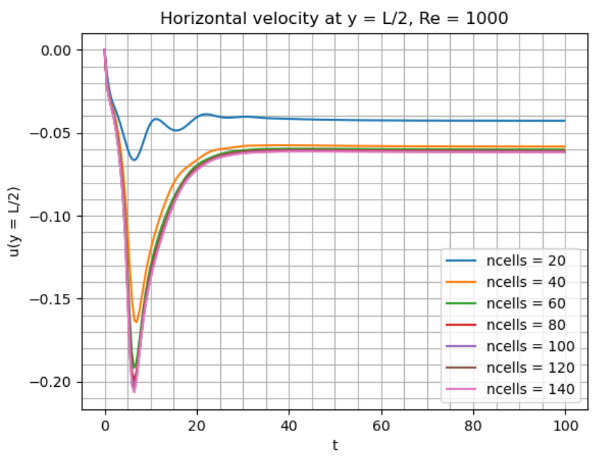
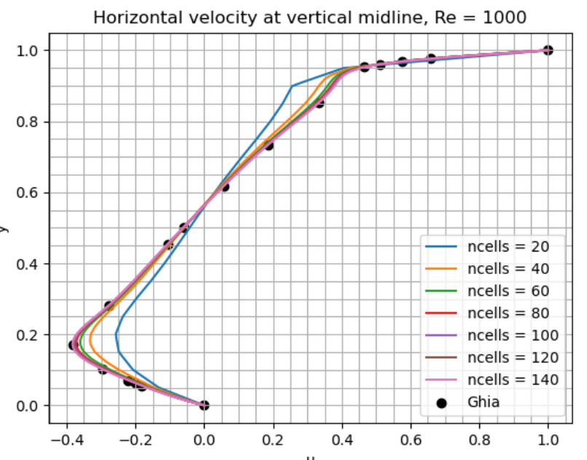
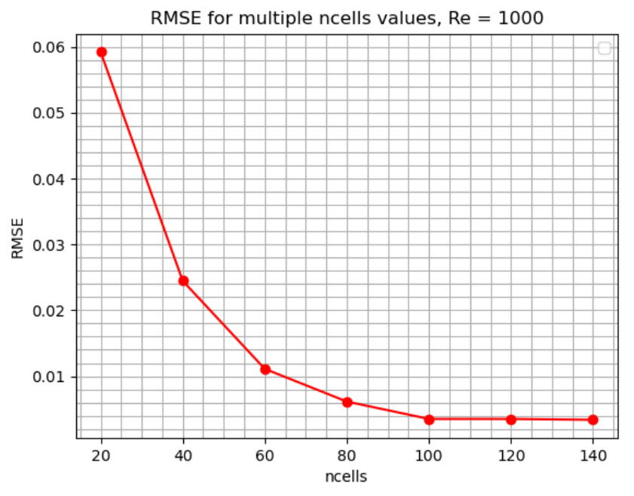
Second step of analysis: Convergence study

Slide 20
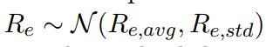
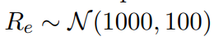
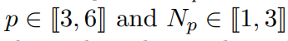
Final step of analysis: Implementing NIPCE
Vary the Reynolds number as follows:
Necessity to build a PCE surrogate for each y coordinate of OpenFOAM results
Simulations for polynomial chaos order and oversampling ratio following:

Slide 21
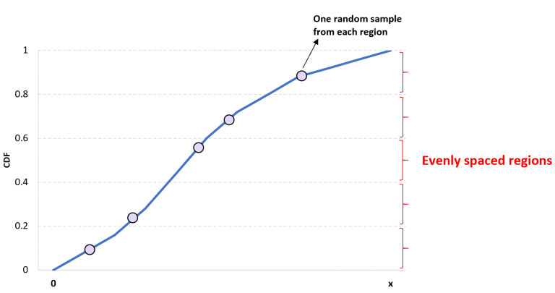
Final step of analysis: Implementing NIPCE
Sampling method used: Latin Hypercube Sampling (LHS)

Slide 22
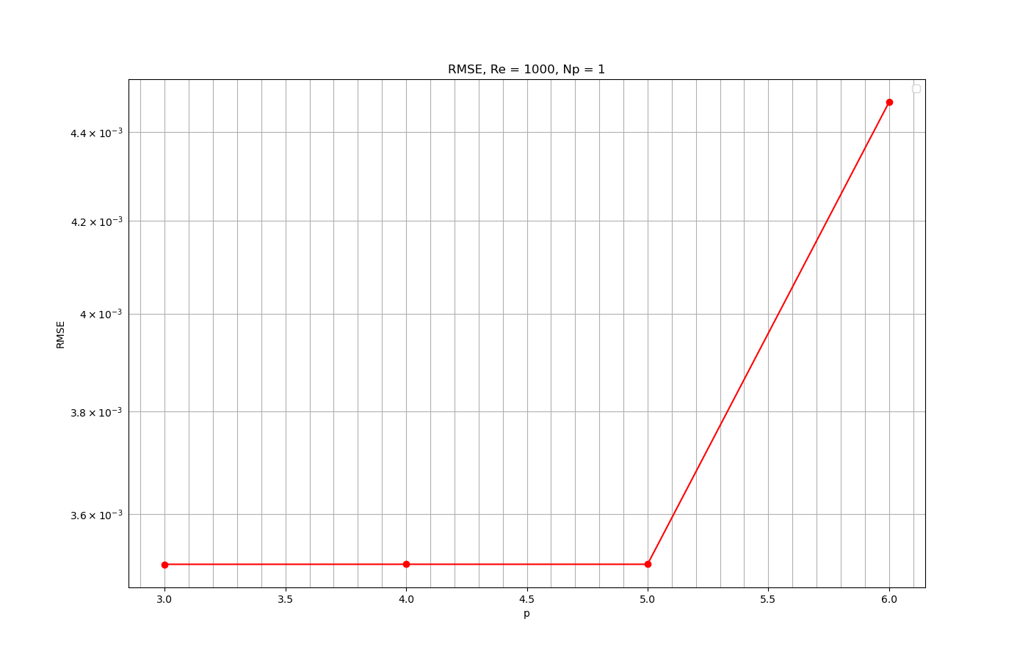
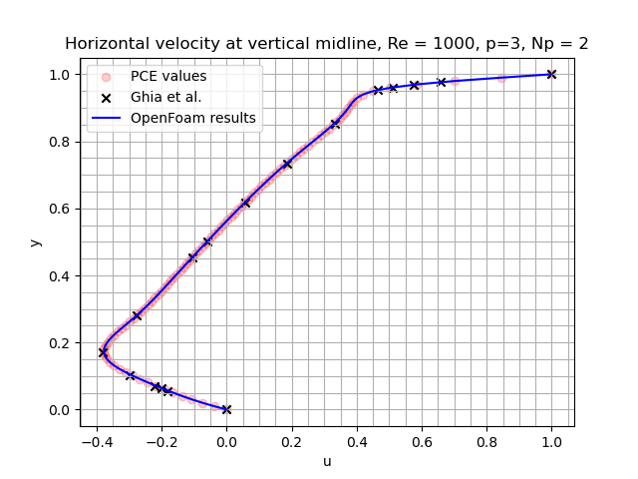
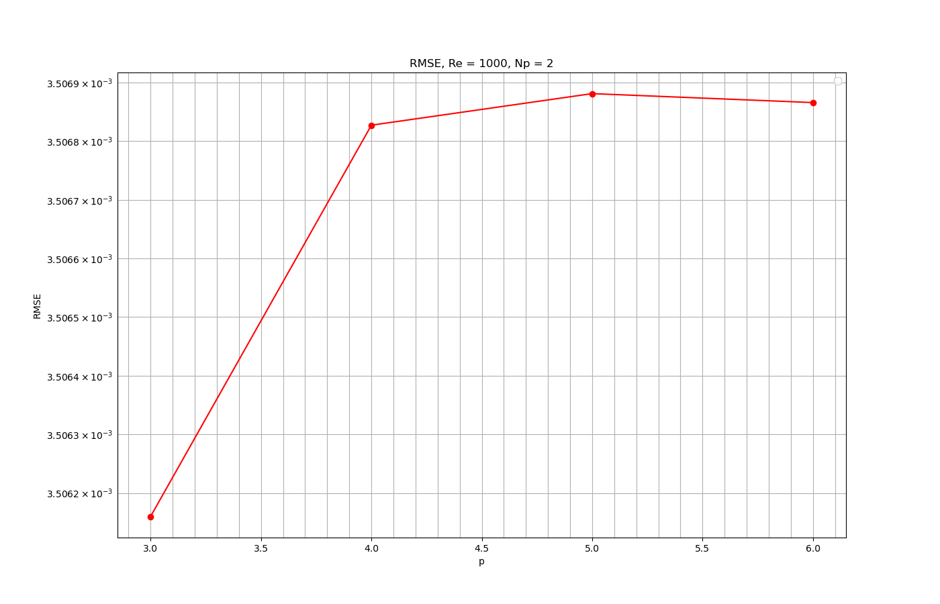
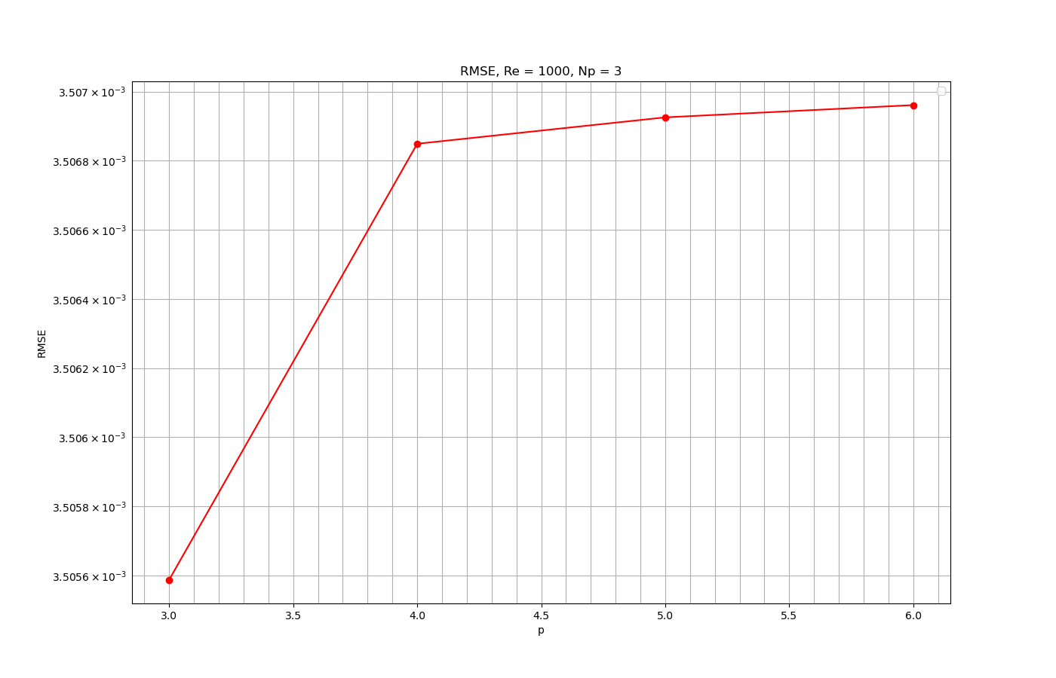
Final step of analysis: Implementing NIPCE

Slide 23
IV. Case study : NACA0012 Airfoil

Slide 24
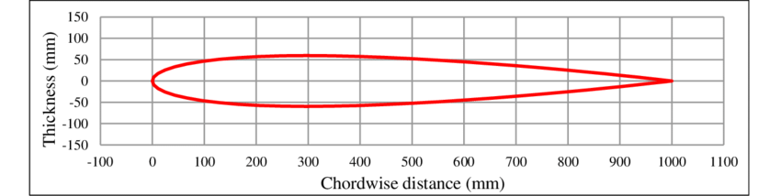
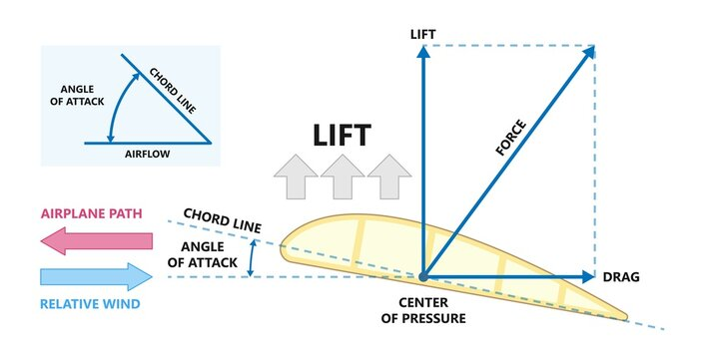
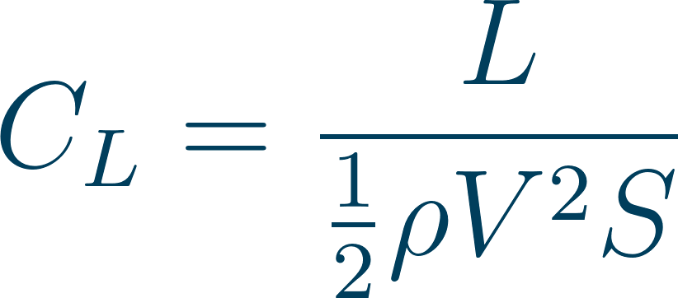
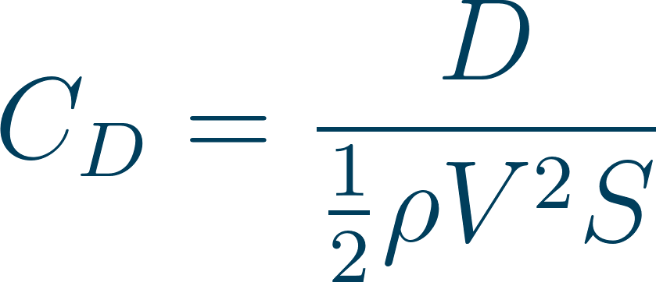
Case Presentation
NACA0012 profile : Standard aerodynamic test model.
Focus on two critical parameters :
Angle of Attack.
Upstream Mach Number.
Simulation Goals :
Compute Cl (Lift Coefficient)
Compute Cd (Drag Coefficient)
NACA0012 Profile
Image Credit : Adobe Stock

Slide 25
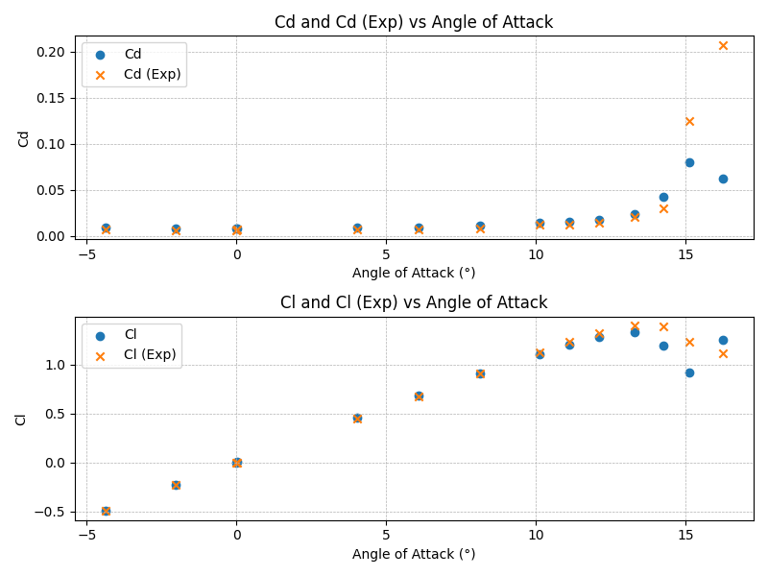
Numerical Implementation on OpenFOAM
Adapted from an existing OpenFOAM case (cf. Appendices for key simulation parameters).
Convergence issues encountered:
High Mach Number instabilities (~0.7)
Stall phenomena at high Angles of Attack (~13°)
Streamlining with Python and validation against NASA Data.
Cl as the only output for UQ. AOA range limited to [-12°,12°] for reliable analysis.

Slide 26
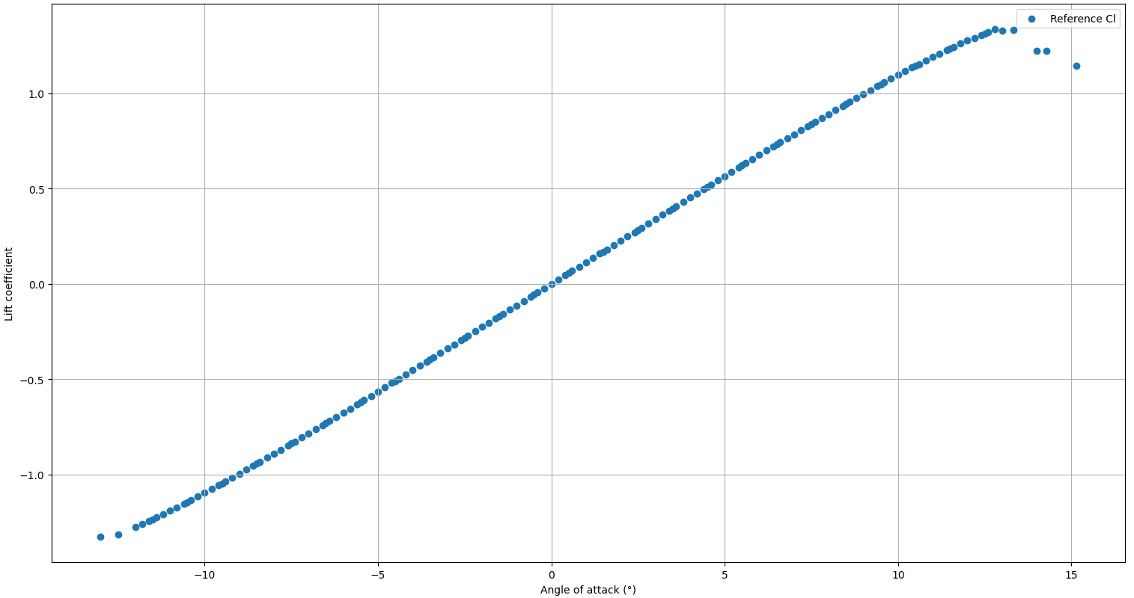
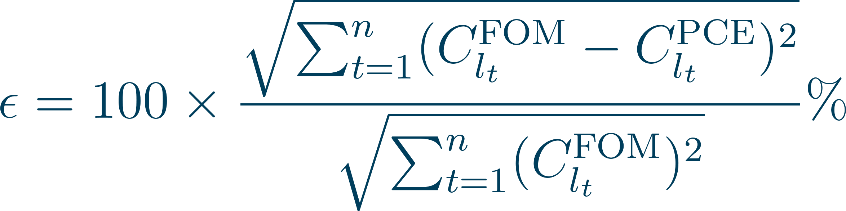
NIPCE Implementation : AOA uncertainty analysis
Study Parameters:
Mach Number set at 0.3
AOA : Normal Distribution, mean 0°, STD 5°
NIPCE Python Implementation:
Inputs : FOM, AOA distribution, Expansion order, Sample size, Sampling method, Fitting Method
Point Collocation Technique to compute the PCE
Parametric study:
Creation of a reference database to assess the surrogate models accuracy
L2 relative error as accuracy metric
Reference values for the Lift Coefficient

Slide 27
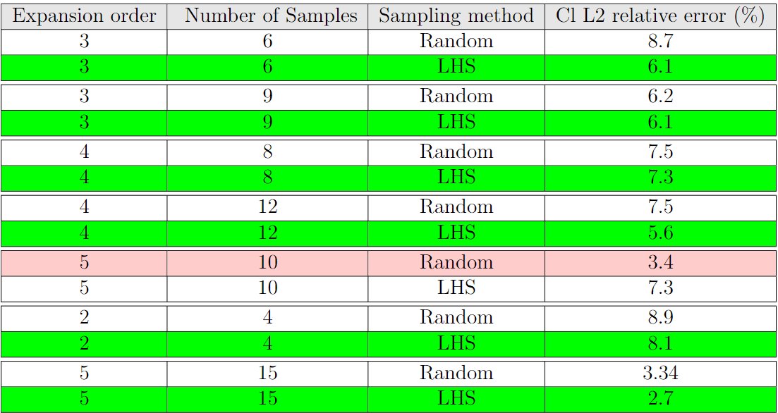
Impact of Sampling Technique : LHS vs Random
LHS outperforms the Random sampling in most cases.

Slide 28
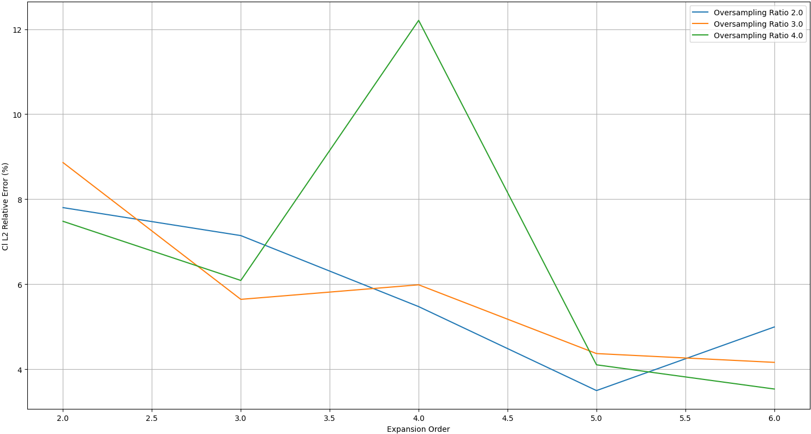
Impact of Expansion Order

Slide 29
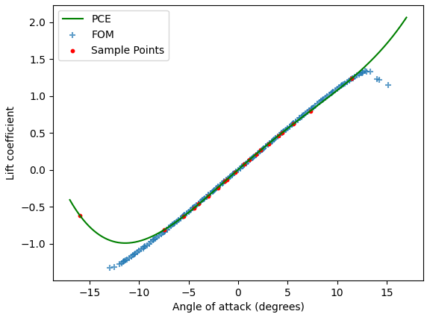
Impact of Expansion Order : Anomaly Explained
PCE obtained with an Expansion order of 4 and an oversampling ratio of 4

Slide 30
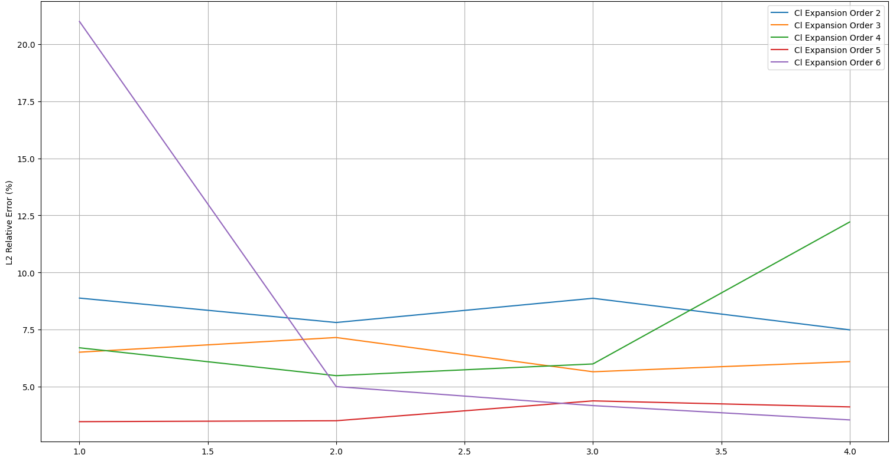
Impact of Oversampling Ratio

Slide 31
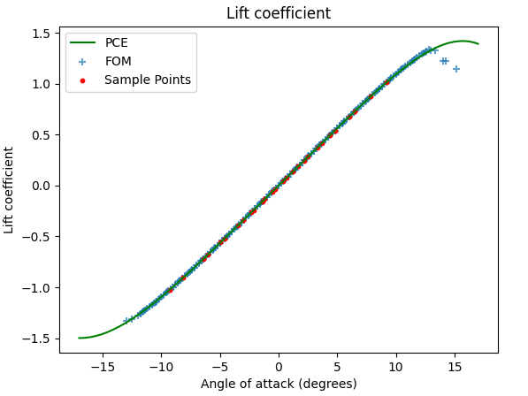
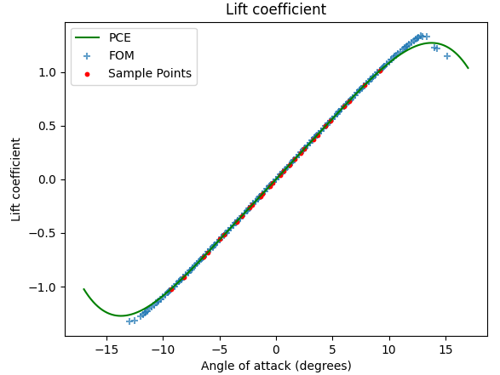
Impact of Fitting Method : Least Squares vs LASSO Regression
Best PCE obtained with Least Squares Regression (Expansion order of 6 and oversampling ratio of 4)
Best PCE obtained with LASSO Regression, α =0.001 (Expansion order of 6 and oversampling ratio of 4)

Slide 32
Discussion
NIPCE Efficacy:
Delivers accurate models with few FOM evaluations
Versatility in handling untrained data points.
Considerations for critical perspective:
Use of L2 relative error and dataset construction could be seen as arbitrary
Some models might better predict specific phenomena despite overall larger error
Dependency on FOM robustness

Slide 33
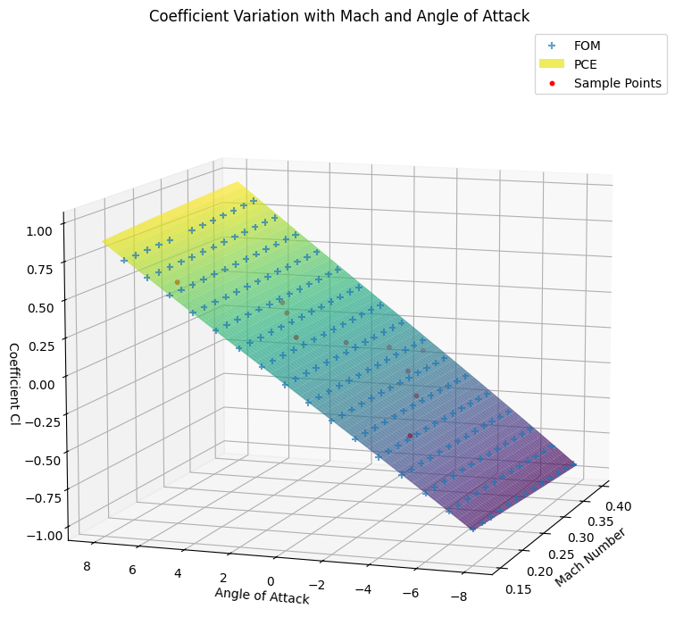
Mach & Two Parameters Uncertainty Analysis
Mach Number as sole parameter: the same study yielded similar outcomes (cf. Appendices)
Two uncertain parameters:
Initial results are promising
Higher computational costs due to additional sample evaluations
PCE obtained for an expansion order of 3 and an oversampling ratio of 1

Slide 34
V. Conclusion and Outlook

Slide 35
Conclusion and Outlook
Theoretical and practical exploration of the NIPCE for method for UQ in CFD simulations.
Effective integration using Chaospy
Parametric investigation
Limitations
Dependent on the FOM’s robustness
Computational capabilities
Future directions:
Deeper dual-parameter uncertainty analysis
Robust FOM solver use
Transition to Object Oriented Programming
Potential comparison of NIPCE results with Monte Carlo simulations
Investigate other libraries
Machine Learning integration (Gaussian Process Modeling, …)

Slide 36
Thank you all for the attention
Any questions ?

Slide 37



Appendix I : Numerical Implementation of NACA0012 Case on OpenFOAM
Fixed Parameter of the CFD simulation
First cell size ~0.2mm

Slide 38




Appendix II : LASSO Regression
The sum of the squares of residuals :
The Lasso regression :
Another formulation :
Contours of the error and constraint functions for the lasso,The solid blue areas are the constraint regions, |β1| + |β2| ≤ s, while the red ellipses are the contours of the RSS
Gareth James, Daniela Witten, Trevor Hastie, Robert Tibshirani. An Introduction to Statistical Learning: with Applications in R. New York: Springer, 2013.

Slide 39

Appendix III : NIPCE Implementation : Mach Number uncertainty analysis
Study Parameters:
AOA set at 5°
Mach : Normal Distribution, mean 0.325, STD 0.85
NIPCE Python Implementation:
Inputs : FOM, AOA distribution, Expansion order, Sample size, Sampling method, Fitting Method
Point Collocation Technique to compute the PCE
Parametric study:
Creation of a reference database to assess the surrogate models accuracy
L2 relative error as accuracy metric
Reference values for the Lift Coefficient

Slide 40

Appendix III : NIPCE Implementation : Mach Number uncertainty analysis
LHS vs Random Sampling

Slide 41

Appendix III : NIPCE Implementation : Mach Number uncertainty analysis
Impact of Expansion Order

Slide 42

Appendix III : NIPCE Implementation : Mach Number uncertainty analysis
Impact of Oversampling Ratio

Slide 43

Appendix III : NIPCE Implementation : Mach Number uncertainty analysis
Expansion Order = 4
Oversampling Ratio = 2
Expansion Order = 4
Oversampling Ratio = 4

